Slide 1
EXCEL PROJECT
BIGMART SALES ANALYSIS

Slide 2
THIS COMPLETE PROJECT IS ABOUT THE SALES OF THE COMPANY NAME AS BIGMART AND USING THE DATA, CAME UP WITH THE VALUEABLE INSIGHTS IN A DASHBOARD
THIS COMPLETE DATA SET HAS 11 COLUMNS AND TOTAL 1001 ROWS
AND THE FIELDS OR TERMS WHICH THIS DATASET HAS ARE AS FOLLOWS:
ITEM IDENTIFIER, ITEM WEIGHT, ITEM FAT CONTENT, ITEM TYPE, ITEM MRP, OUTLET IDENTIFIER, OUTLET ESTABLISHMENT YEAR, OUTLET SIZE, OUTLET LOCATION TYPE, OUTLET TYPE, ITEM OUTLET SALES, ETC.

Slide 3
case
WHAT IS THE HIGHEST AND LOWEST SALES IN PARTICULAR YEAR?
WHICH ITEM TYPE HAS THE HIGHEST AND LOWEST SALES?
WHAT IS THE MAXIMUM AND MINIMUM ITEM WEIGHT OF A ITEM TYPE?
WHICH TYPE OF OUTLET HAS THE HIGHEST AND LOWEST SALES?
WHAT IS THE TOTAL ITEM MRP WITH RESPECT TO ITEM TYPE?
IN WHICH YEAR THE SALES WERE HIGH AND LOW?
WHAT IS THE SALES OF THE OUTLET TYPE ACORDING TO THE OUTLET SIZE?
WHAT IS TOTAL COUNT OF OUTLET TYPE?
WHAT IS THE TOTAL SALES OF PARTICULAR LOCATION

Slide 4
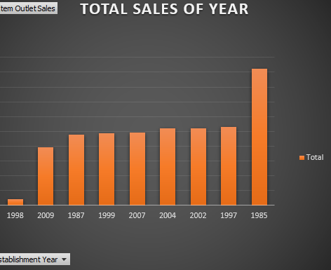
WHAT IS THE HIGHEST AND LOWEST SALES IN PARTICULAR YEAR?
HIGHEST 1985 461927
LOWEST 1998 20765

Slide 5
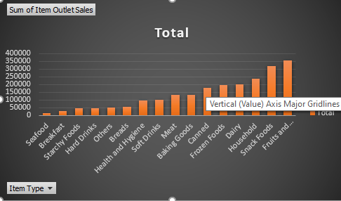
WHICH ITEM TYPE HAS THE HIGHEST AND LOWEST SALES?
HIGHEST Fruits and Vegetables
LOWEST SEAFOOD

Slide 6
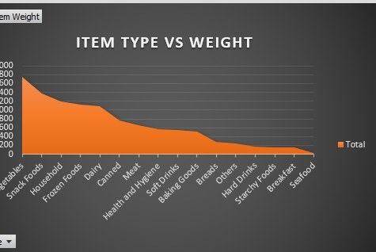
WHAT IS THE MAXIMUM AND MINIMUM ITEM WEIGHT OF A ITEM TYPE? MAXIMUM 1742
MINIMUM 34

Slide 7
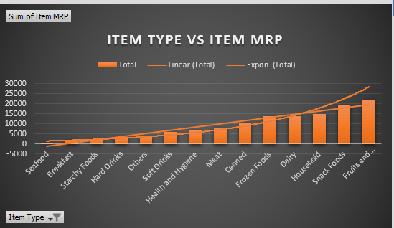
WHAT IS THE TOTAL ITEM MRP WITH RESPECT TO ITEM TYPE?
TOTAL 127003

Slide 8
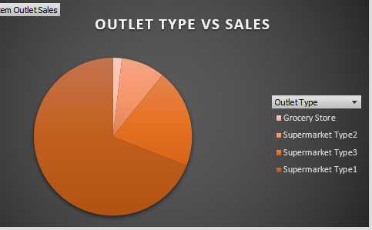
WHICH TYPE OF OUTLET HAS THE HIGHEST AND LOWEST SALES?
Grocery Store 39896
Supermarket Type2 195710
Supermarket Type3 442796
Supermarket Type1 1512239

Slide 9
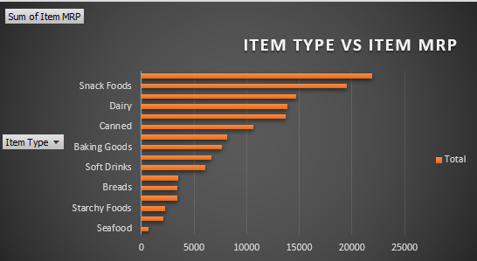
WHAT IS THE TOTAL ITEM MRP WITH RESPECT TO ITEM TYPE?
TOTAL MRP 138088

Slide 10
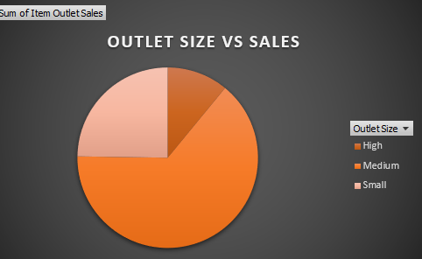
WHAT IS THE SALES OF THE OUTLET TYPE ACORDING TO THE OUTLET SIZE?
HIGH 239919
MEDIUM 1408217
SMALL 542505

Slide 11
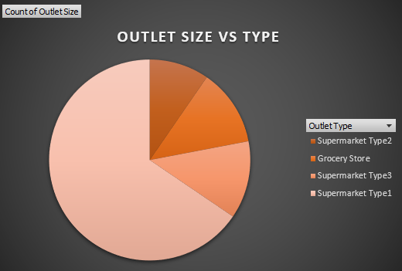
WHAT IS TOTAL COUNT OF OUTLET TYPE?
SUPERMARKET TYPE 1 655
SUPERMARKET TYPE 3 125
GROCERY STORE 124
SUPERMARKET TYPE 2 96

Slide 12
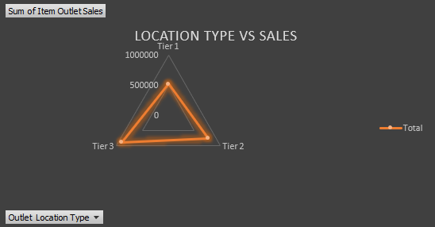
WHAT IS THE TOTAL SALES OF PARTICULAR LOCATION
TIER 3 899190
TIER 2 765160
TIER 1 526291

Slide 13
THANK YOU

